Slide 1
Cloud and Fog Computing
Deepak Gangadharan
Assistant Professor, IIIT Hyderabad
Intro to IoT (Spring 2022)

Slide 2
Introduction
A statement by Leonard Kleinrock (chief scientist of the original ARPANET) in 1969: “As of now, computer networks are still in their infancy, but as they grow up and become sophisticated, we will probably see the spread of computer utilities which, like present electric and telephone utilities, will service individual homes and offices across the country”
Users need to pay providers only when they access services
No need to invest or experience difficulties in building and maintaining complex IT infrastructure
Vision of computing utilities based on a service-provisioning model
Intro to IoT (Spring 2022)

Slide 3
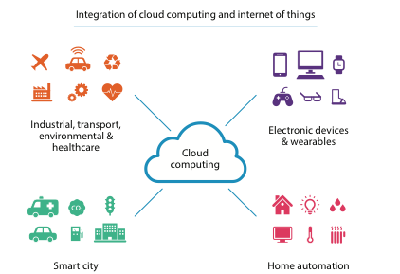
Introduction (contd…)
Users access services based on requirements without knowledge about where it is hosted.
Allows renting infrastructure, runtime environments, and services on a pay-per-use-basis
End users can access their documents and data anytime, anywhere and from any device connected to the Internet.
Source: https://internetinitiative.ieee.org/images/files/newsletter/sept_2018/cloud_computing.png
Intro to IoT (Spring 2022)

Slide 4
Introduction (contd…)
Source: Mastering Cloud Computing: Foundations and Application Programming
Intro to IoT (Spring 2022)

Slide 5
Definition
U.S. National Institute of Standards Technology (NIST) defines it as
“A model for enabling ubiquitous, convenient, on-demand network access to a shared pool of configurable computing resources (e.g., networks, servers, storage, applications, and services) that can be rapidly provisioned and released with minimal management effort or service provider interaction.”
Introduces concept of everything as a service (XaaS)
Focuses on delivering services with a given pricing model
Source: Mastering Cloud Computing: Foundations and Application Programming
Intro to IoT (Spring 2022)

Slide 6
Enabling Technology - Virtualization
Fundamental component of cloud computing
Allows the creation of a secure, customizable, and isolated execution environment for running applications
Provides an abstract environment – virtual hardware or an operating system to run applications
Virtualization also for storage, memory and networking
Intro to IoT (Spring 2022)

Slide 7
Enabling Technology - Virtualization
Source: Mastering Cloud Computing: Foundations and Application Programming
Intro to IoT (Spring 2022)

Slide 8
Features of Virtualization
Sharing:
Separate computing environments within a host allows fully exploiting the resources
Aggregation:
A group of distinct hosts can be tied together and provided to guests as a single host
Isolation:
No interference between guests and between guest and host
Intro to IoT (Spring 2022)

Slide 9
Cloud Architecture Models
Source: Internet of Things for Architects by Perry Lea
Intro to IoT (Spring 2022)

Slide 10
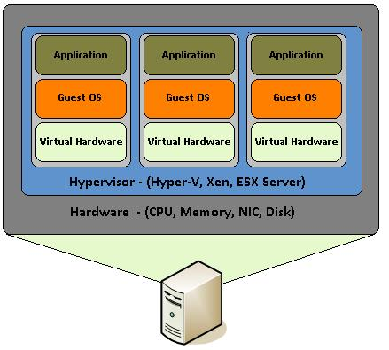
Infrastructure as a Service (IaaS)
Delivers customizable infrastructure (ranging from single servers to entire infrastructures including network devices, load balancers, database and Web servers) on demand
Main technology used – Hardware Virtualization! → Virtual machines (VMs) configured on-demand
Virtual machines – Atomic components deployed and priced based on the features of the virtual hardware, i.e., memory, number of processors, disk storage, etc.
IaaS brings all the benefits of hardware virtualization such as workload partitioning, application isolation, hardware tuning, etc.
Examples: Amazon EC2 and S3, Google Compute Engine, Microsoft Azure
Source: https://upload.wikimedia.org/wikipedia/commons/0/08/Hardware_Virtualization.JPG
Intro to IoT (Spring 2022)

Slide 11
IaaS Reference Implementation
Three principle layers – Physical Infrastructure, Infrastructure Management Software and User Interface
User Interface:
Provides access to services exposed by infrastructure management software
Based on Web services, RESTful APIs
Core features in Infrastructure Management Software (IMS) layer
Source: Mastering Cloud Computing: Foundations and Application Programming
Intro to IoT (Spring 2022)

Slide 12
IaaS Reference Implementation (contd…)
IMS Layer:
Management of VMs
Scheduler in charge of allocating the execution of VM instances and interacting with other components
Pricing/Billing: Accounts cost of executing each VM instance and maintains data for charging user
Monitoring: Tracks execution of each VM instance and maintains data for system performance reporting/analysis
Reservation: Stores information of all VM instances that have been executed or will be executed in future
Source: Mastering Cloud Computing: Foundations and Application Programming
Intro to IoT (Spring 2022)

Slide 13
IaaS Reference Implementation (contd…)
Physical Infrastructure:
Specific infrastructure depends on the specific use of the cloud
Service provider most likely uses a massive datacenter containing hundreds or thousands of nodes
Cloud infrastructure in a small, medium sized enterprise, mostly relies on a cluster
The smallest scale considers aggregation of heterogeneous different types of resources
From architectural viewpoint, virtual resources rented from external IaaS providers are also included
Source: Mastering Cloud Computing: Foundations and Application Programming
Intro to IoT (Spring 2022)

Slide 14
Platform as a Service (PaaS)
Provides a development and deployment platform for running applications in the cloud, i.e. exposes interfaces for it
Provides middleware on top of which applications are built
Application management is the core functionality of middleware
Provides a runtime environment but no service exposed to manage the underlying infrastructure
Core middleware manages resources and scaling applications on demand
Source: Mastering Cloud Computing: Foundations and Application Programming
Intro to IoT (Spring 2022)

Slide 15
PaaS Implementations
Intro to IoT (Spring 2022)

Slide 16
Software as a Service (SaaS)
Software delivery model that provides access to applications through the internet as a Web-based service
Customers neither need to install anything on their premises nor have to pay huge up-front costs for software
Application is deployed from a centralized datacenter across a network providing access/use based on a fee
Example: Image editing applications
Intro to IoT (Spring 2022)

Slide 17
Cloud Deployment Models
Public cloud (external cloud)
Computing resources provisioned from an off-site third party provider
Applications from different users likely to be mixed together
QoS management very important
Can offer any kind of service: IaaS, PaaS or SaaS
Private cloud (internal cloud)
Built for exclusive use of one client
Full control over data, security and quality of service
Important for institutions like government and military agencies for processing or storing sensitive data
Built and managed by a company’s IT organization or a cloud provider
Source: Mastering Cloud Computing: Foundations and Application Programming
Intro to IoT (Spring 2022)

Slide 18
Cloud Deployment Models (contd…)
Hybrid cloud
Combines multiple public and private cloud models
Complexity in determining how to distribute applications
Dynamic provisioning gives the ability to acquire virtual machines on demand to scale the distributed system and release them later
Scheduler is relatively more complex to identify the resources from the public cloud
Source: Mastering Cloud Computing: Foundations and Application Programming
Intro to IoT (Spring 2022)

Slide 19
Cloud Deployment Models (contd…)
Community cloud
Distributed systems created by integrating services of different clouds to address the needs of a specific community, industry or a business sector
Examples of sectors: Media industry, healthcare industry, energy and other core industries, scientific research
Source: Mastering Cloud Computing: Foundations and Application Programming
Intro to IoT (Spring 2022)

Slide 20
Cloud Platforms in Industry
Intro to IoT (Spring 2022)

Slide 21
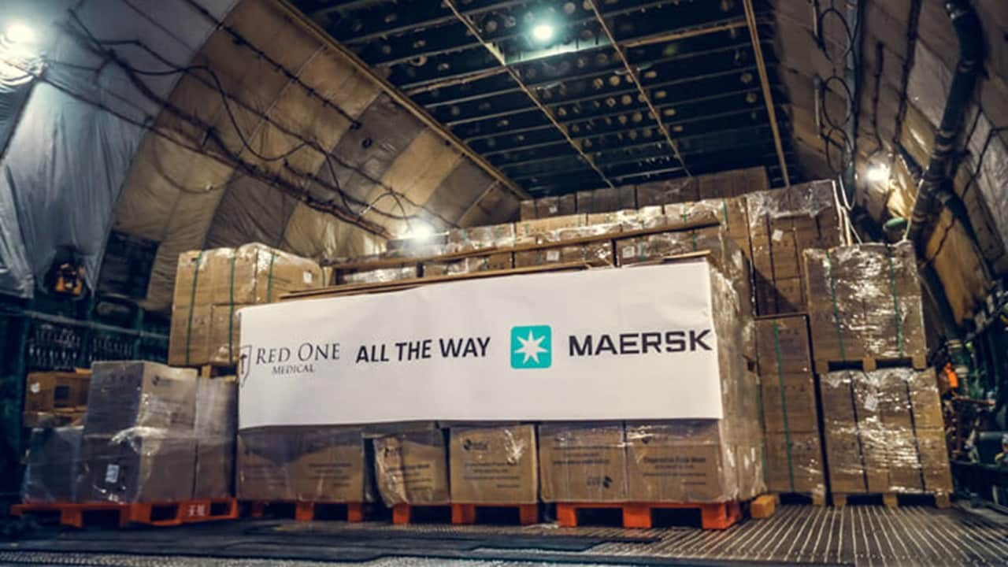
Cloud-based IoT Application
Maersk: Global Air Freight Transportation
Industrialized cargo shipping services
End-to-end supply chain logistics
Uses Microsoft Azure IoT technology to detect and control 3,80,000 refrigerated containers as they travel across the globe
Source: Maersk Air Freight | Maersk
Intro to IoT (Spring 2022)

Slide 22
Features of Cloud Computing
Scalability and on-demand services
Provides resources and services on-demand
Resources scalable over several data centers
User-centric interface
Can be accessed by Web services and Internet browsers
Guaranteed Quality of Service (QoS)
Guarantees QoS for users in terms of hardware/CPU performance, bandwidth and memory capacity
Pricing
Users pay for services and capacity based on the need
Intro to IoT (Spring 2022)

Slide 23
Challenges in Cloud Computing
Performance
Users far away from cloud providers may experience high latency
Security and Privacy
Concerns over vulnerability of attacks, when information and critical IT resources are outside firewall
New attack surfaces possible between VMs
Bandwidth costs
Reliability
Intro to IoT (Spring 2022)

Slide 24
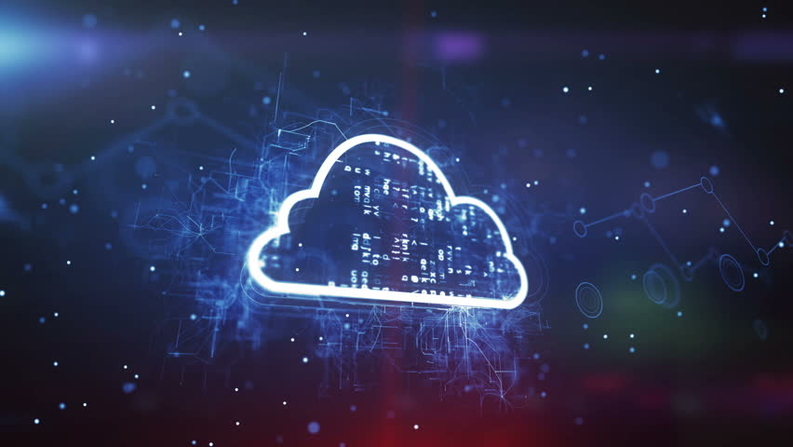
Challenges of Cloud Computing - Summary
Large data volume
High Latency
Resiliency impractical
High transport cost
Intro to IoT (Spring 2022)

Slide 25
Fog Computing

Slide 26
Motivation
Ever increasing IoT devices worldwide – 41.6 billion by 2025 (Data by International Data Corporation)
Data generated by IoT devices will be 79.4 zettabytes by 2025 (Requires 1000 data centers!)
Cloud Computing Characteristics
High latency due to significant distance between end devices and cloud
Centralized model of computing
No location awareness
Poor support for mobility
Vulnerable to security attacks
Issues are Volume, Latency and Bandwidth
Intro to IoT (Spring 2022)

Slide 27
Fog Computing - Features
Source: https://www.everestgrp.com/2019-05-edge-computing-characteristics-and-benefits-market-insights-50131.html/
Intro to IoT (Spring 2022)

Slide 28
Fog Computing
The fog metaphor comes from the term for a cloud close to the ground, just as fog concentrates on the edge of the network.
Fog computing is not meant to replace cloud computing, but to enhance its capabilities and improve performance.
Fog computing introduces an intermediate layer called fog that is designed to process the communication data between the cloud and end users.
Source : https://internetofthingsagenda.techtarget.com/definition/fog-computing-fogging
Intro to IoT (Spring 2022)

Slide 29
Fog Topologies
Can exist in many forms
Need to consider several aspects when designing an end-to-end fog system – constraints such as cost, processing load, manufacturer interface, and east-west trafficking
A fog network →
simple as a fog-enabled edge router connecting sensors to a cloud service
complex multi-tier fog hierarchy with different processing ability and roles at each tier while distributing processing loads
Intro to IoT (Spring 2022)

Slide 30
Fog Topologies (contd…)
Factors determining the model are
Data volume reduction: Ingesting large amounts of data and deriving particular events in real-time
Number of edge devices: if only one sensor, then limited data and so fog edge not justified → with more sensors or dynamic addition of sensors, fog topology needs to be scaled
Fog node capabilities: some nodes suited for connectivity to WPAN systems, while other nodes may have additional processing bandwidth
System reliability: redundant nodes may be needed in the situation of node failures
Intro to IoT (Spring 2022)

Slide 31
Fog Topologies
Case 1
Case 3
Case 2
Case 4
Intro to IoT (Spring 2022)

Slide 32
Multi-tier Fog Topology – City Lighting Example
Cameras sense moving pedestrians and traffic
Fog nodes closest to cameras perform aggregation and feature extraction and pass it upstream
Parent fog node receives features and performs image recognition → events reported to cloud
Cloud will register the event and signal to a set of street lights in the pedestrian’s vicinity to increase illumination
Intro to IoT (Spring 2022)

Slide 33
Example 1: Vehicle Control System
Intro to IoT (Spring 2022)

Slide 34
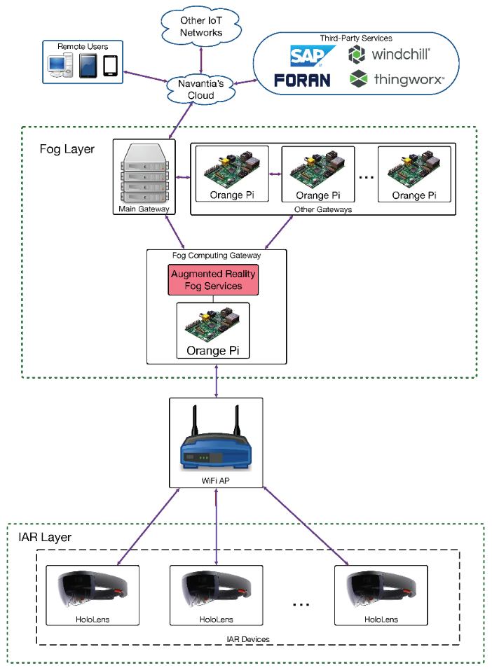
Example 2: Augmented Reality
Intro to IoT (Spring 2022)

Slide 35
Reference Textbook
Buyya, R., Vecchiola, C. and Selvi, S.T., 2013. Mastering cloud computing: foundations and applications programming. Newnes.
Lea, P., 2018. Internet of Things for Architects: Architecting IoT solutions by implementing sensors, communication infrastructure, edge computing, analytics, and security. Packt Publishing Ltd.
Intro to IoT (Spring 2022)

Slide 36
Thank You!!

